Slide 1
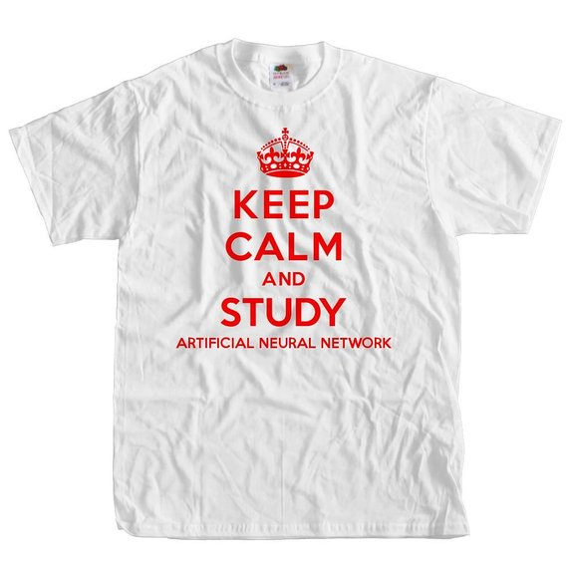

Slide 2
Artificial Neural Network basics
Qingkai Kong
2016-12-02
http://seismo.berkeley.edu/qingkaikong/

Slide 3
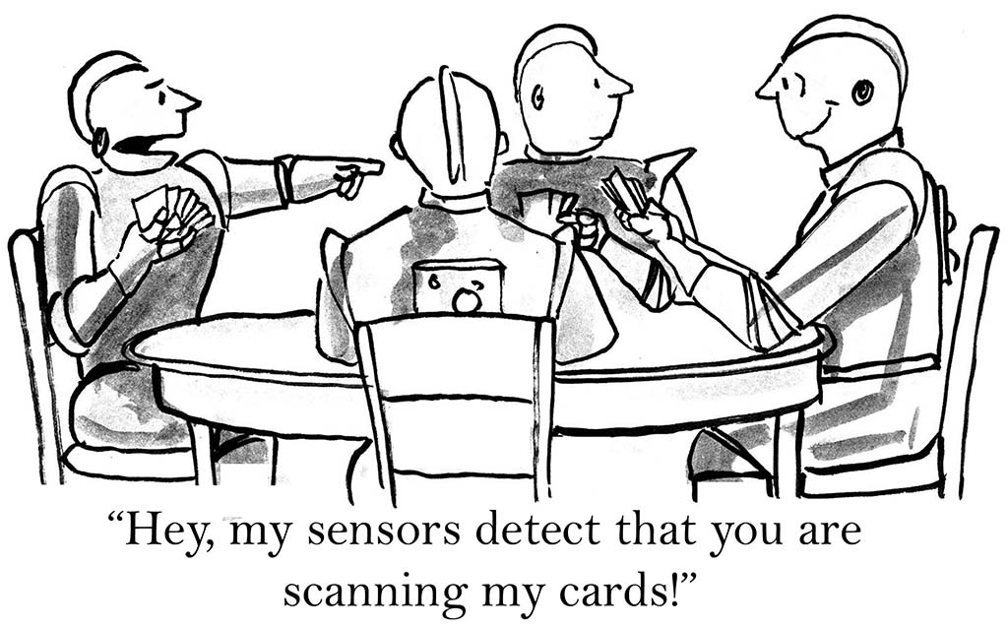

Slide 4
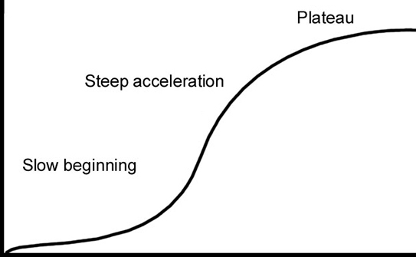
Real world example
Step by step ANN
Learning curve
Gentle introduction
Workshop time

Slide 5
Real world example
Step by step ANN
Learning curve
Gentle introduction
What’s ML
ANN history
ANN overview
Workshop time

Slide 6

What is machine learning?

Slide 7
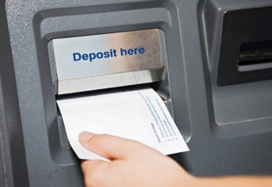



Self-driving car
Voice recognition
…

Slide 8
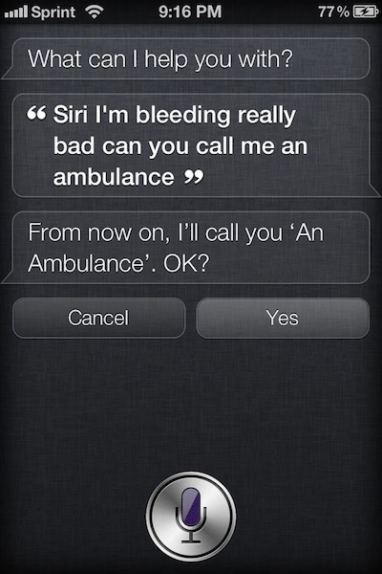
Not always working

Slide 9
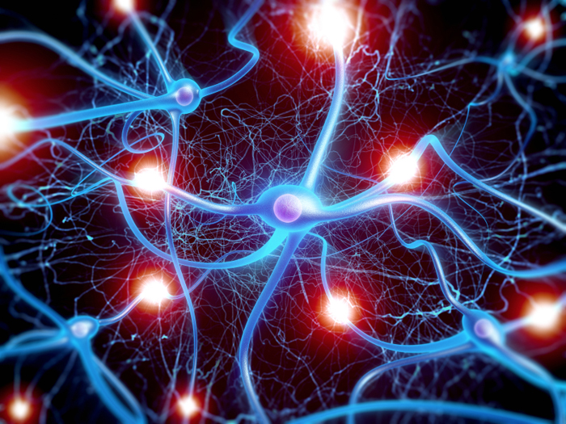

Slide 10
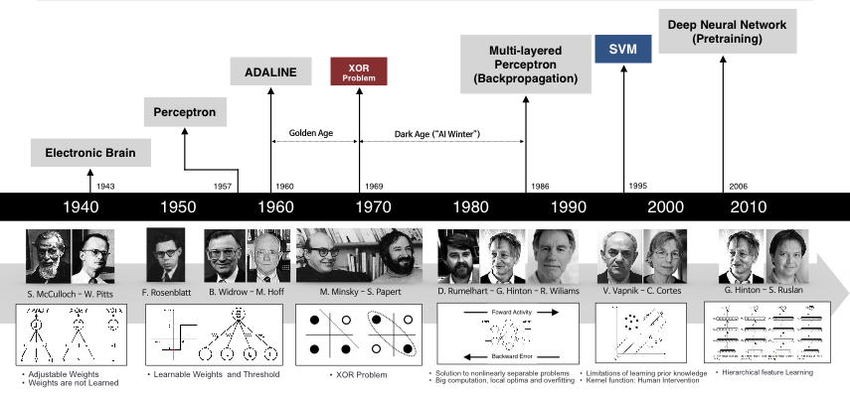
1980s
Rebirth
2006
Deep
1970s
Winter
1940s
Birth

Slide 11
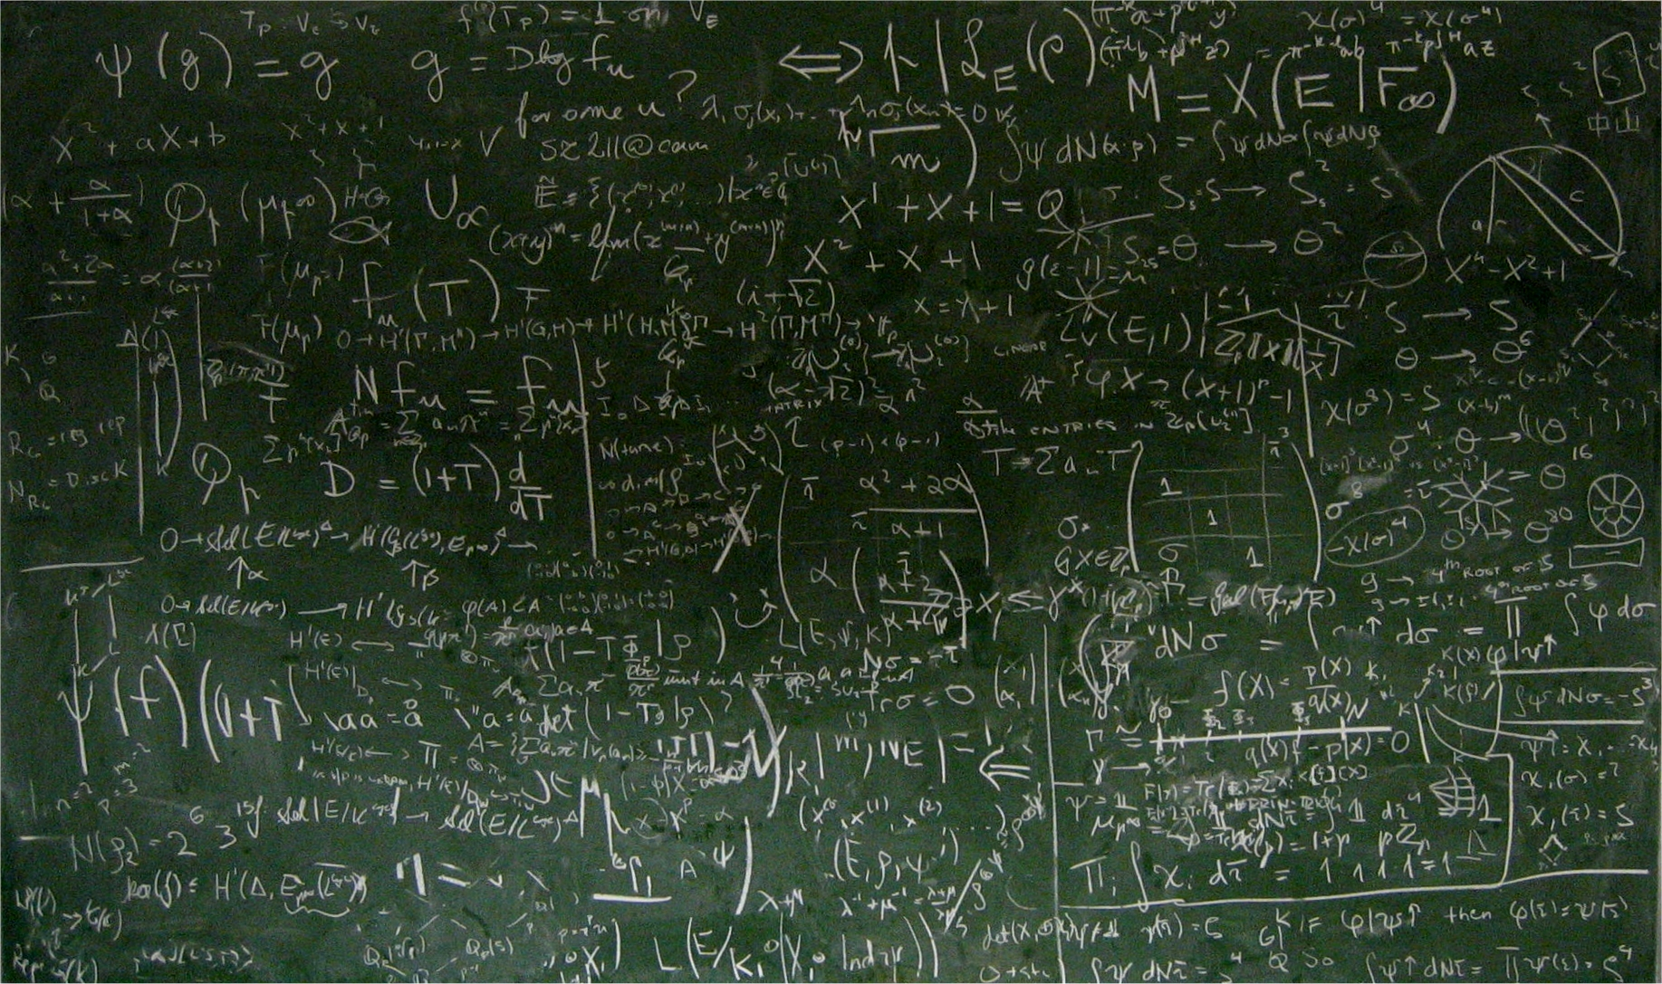


Slide 12
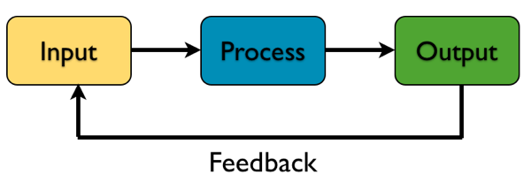
ANN in simple view

Slide 13
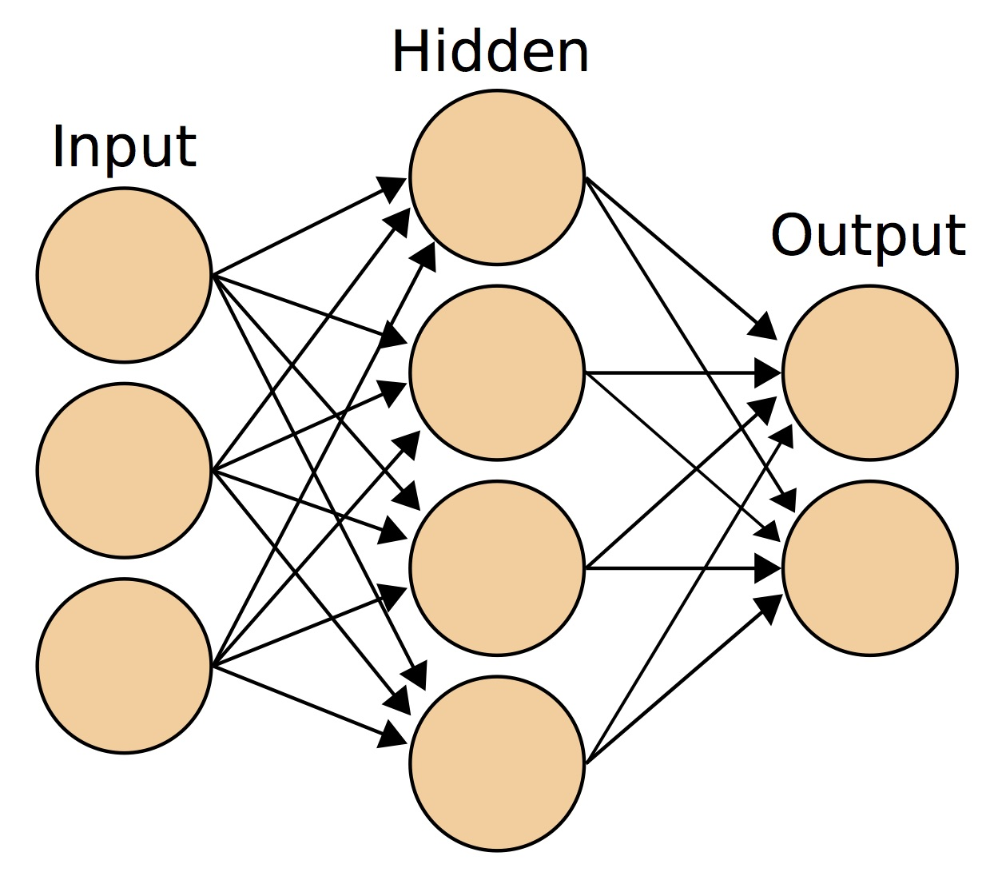
ANN jargons
Notes:
It's a mathematical construct to fit a model to historical data, and use this model to forecast the future.

Slide 14

What’re the weights

Slide 15
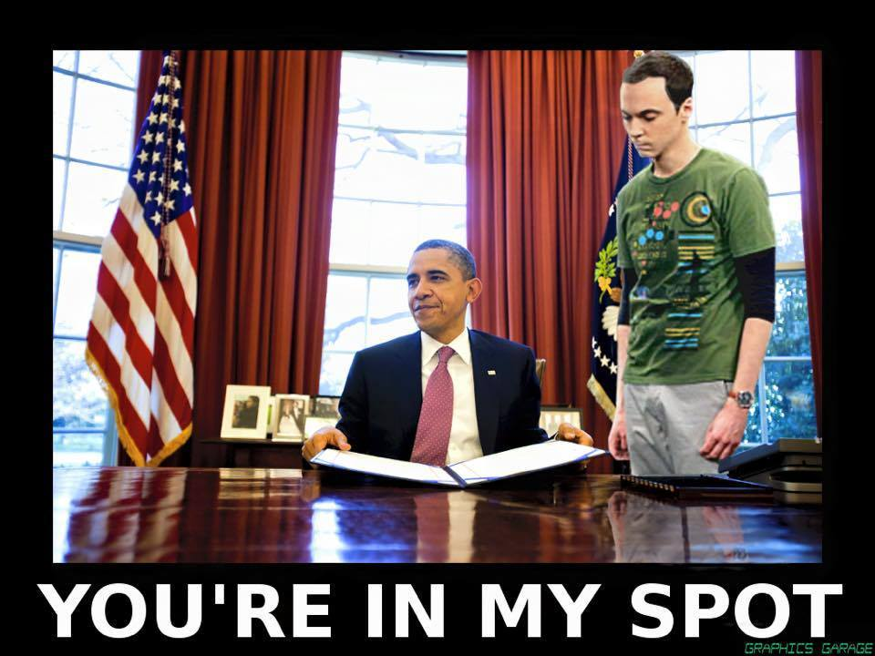

Slide 16

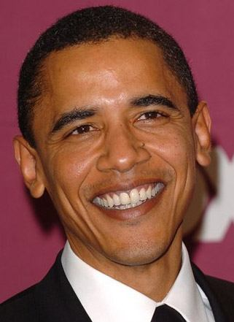
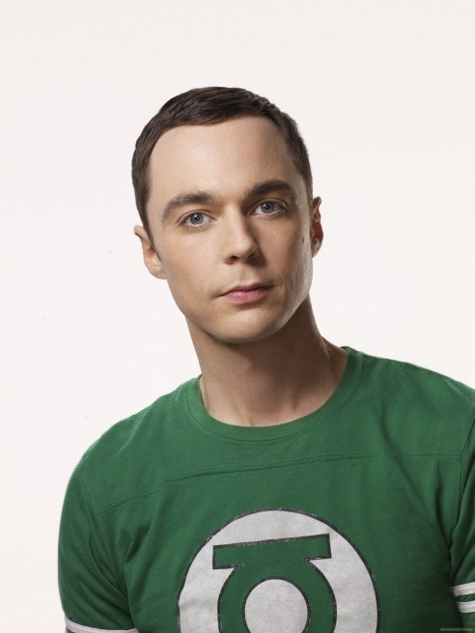

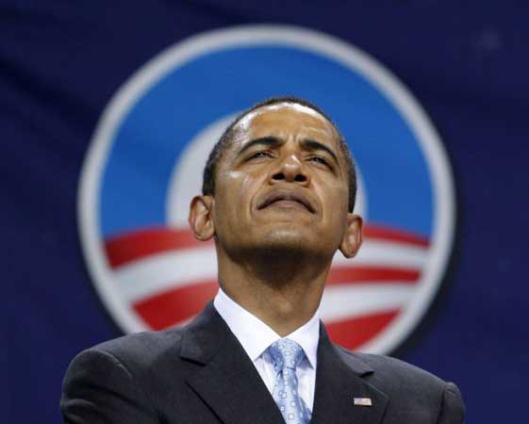
Intuitive Artificial Neural Network
Input
Output
w₁
F(eye×w₁+nose×w₂+…+mouth×w_{n})
w₂
Sheldon Cooper?
.
.
.
w_{n}

Slide 17

Intuitive Artificial Neural Network
Input
Output
w₁
F(eye×w₁+nose×w₂+…+mouth×w_{n})
w₂
Sheldon Cooper?
.
.
.
w_{n}
feedback

Slide 18
Intuitive Artificial Neural Network
Input
Output
w₁
F(eye×w₁+nose×w₂+…+mouth×w_{n})
w₂
Sheldon Cooper?
.
.
.
w_{n}
feedback

Slide 19
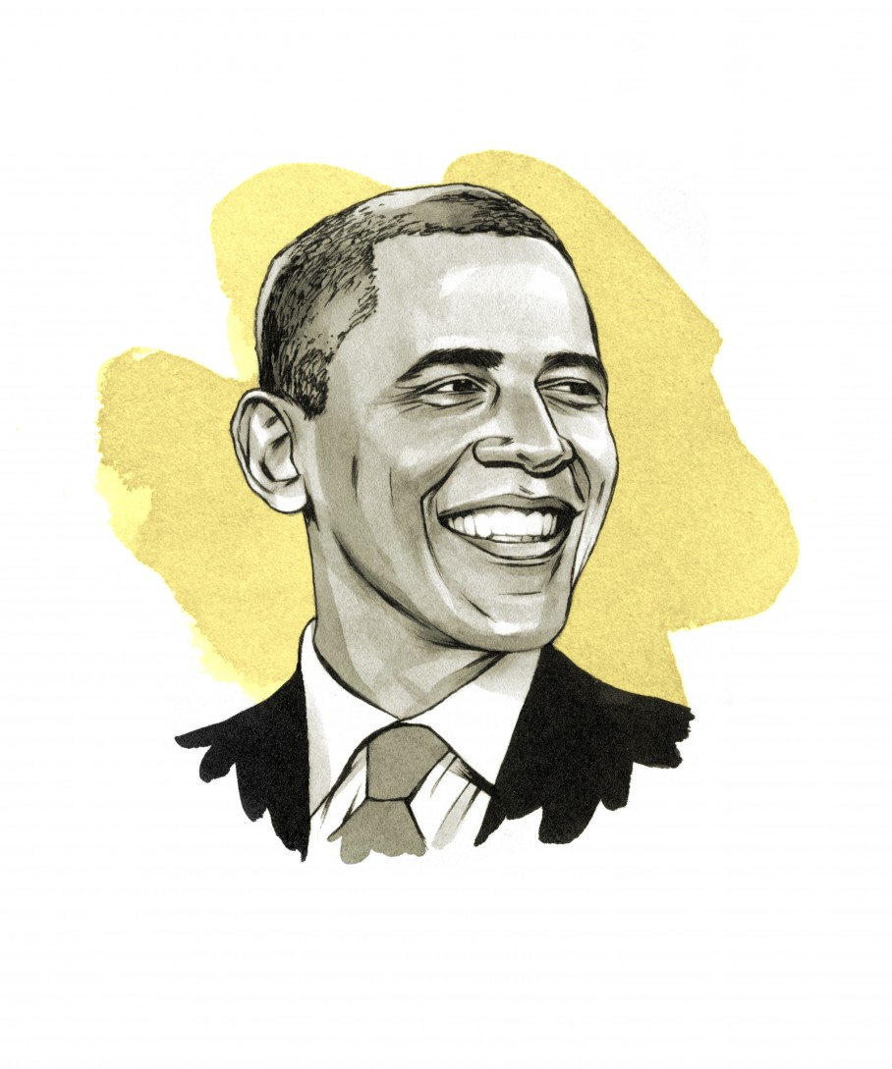
Intuitive Artificial Neural Network
Input
Output
w₁
F(eye×w₁+nose×w₂+…+mouth×w_{n})
w₂
.
.
.
w_{n}

Slide 20
Real world example
Step by step ANN
Perceptron
Backpropagation
Learning curve
Gentle introduction
What’s ML
ANN history
ANN overview
Workshop time

Slide 21


Slide 22

Learn arts
https://arxiv.org/abs/1508.06576v1
https://deepart.io/

Slide 23
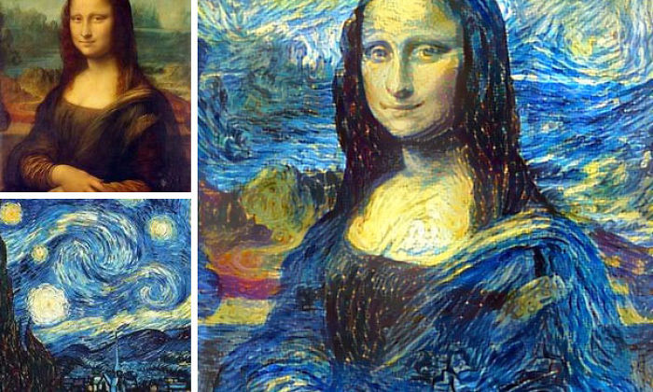
http://junkhost.com/2016/03/man-combines-random-peoples-photos-using-neural-networks-and-the-results-are-amazing/

Slide 24
Input
1
ω₀
X
Output
ω₁
feature1
Σ
f
y
ω₂
ω₃
X – input data
y – output target
ω_{i} – weights
Σ – summation
f – activation function
Blue circle – bias
feature2
feature3
Σ = ω₀x₀+ω₁x₁+ω₂x₂+ω₃x₃+…+ω_{n}x_{n}
f = f(ω₀x₀+ω₁x₁+ω₂x₂+ω₃x₃+…+ω_{n}x_{n})

Slide 25
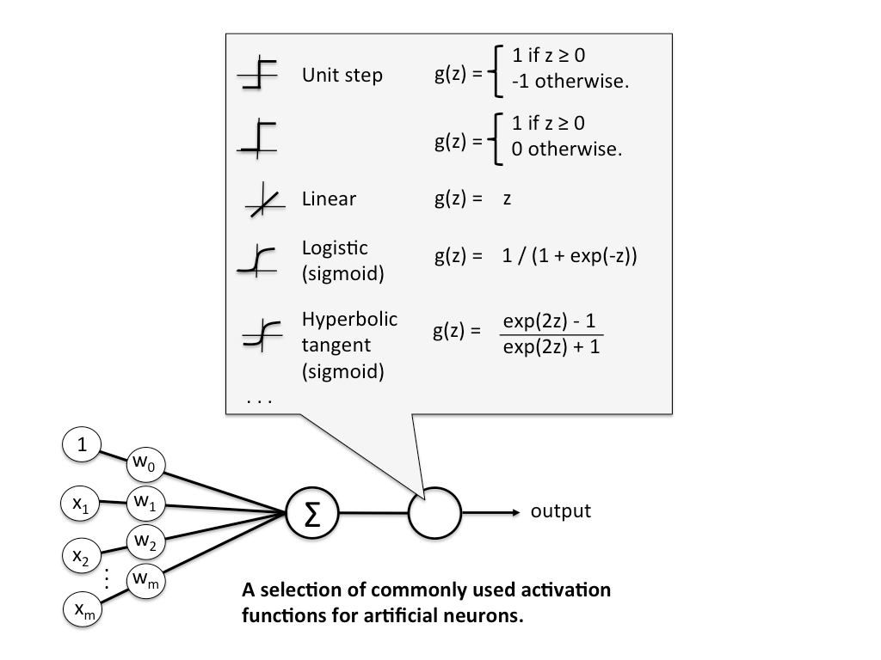

Slide 26
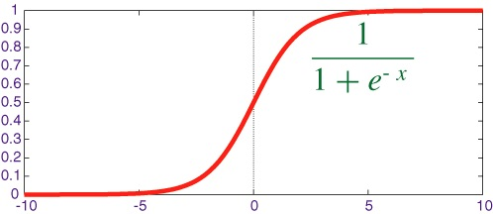
More activation function
z = ω₀x₀+ω₁x₁+ω₂x₂+ω₃x₃+…+ω_{n}x_{n}

Slide 27
Input
1
ω₀
X
Output
ω₁
feature1
Σ
f
y
ω₂
ω₃
X – input data
y – output target
ω_{i} – weights
Σ – summation
f – activation function
Blue circle – bias
feature2
feature3
Σ = ω₀x₀+ω₁x₁+ω₂x₂+ω₃x₃+…+ω_{n}x_{n}
f = f(ω₀x₀+ω₁x₁+ω₂x₂+ω₃x₃+…+ω_{n}x_{n})
y = f (This is our estimation)

Slide 28
Input
1
ω₀
X
Output
ω₁
feature1
Σ
f
y
ω₂
ω₃
X – input data
y – output target
ω_{i} – weights
Σ – summation
f – activation function
Blue circle – bias
feature2
feature3
Error = Target - Estimation

Slide 29


Slide 30
How to update weights
Error = Target - Estimation

Slide 31
How to update weights
Error = Target - Estimation
Learning:
Update weights to reduce error next time!

Slide 32


Slide 33
Look at errors closer
Error = Target - Estimation
Target
0
1

Slide 34
Look at errors closer
Error = Target - Estimation
Target
0
1
Three cases:
Error < 0: Target is 0, estimation is not 0
Error > 0: Target is 1, estimation is not 1
Error = 0: Estimation correct

Slide 35
Look at errors closer (assume inputs are positive)
Cases 1:
Error < 0: Target is 0, estimation is not 0

Slide 36

Look at errors closer (assume inputs are positive)
Cases 1:
Target is 0
Estimation is 0.3
Error = 0 – 0.3 =-0.3

Slide 37
Look at errors closer (assume inputs are positive)
Cases 1:
Target is 0
Estimation is 0.3
Error = 0 – 0.3 =-0.3
z_{update}
z

Slide 38
Look at errors closer (assume inputs are positive)
Cases 1:
Target is 0
Estimation is 0.3
Error = 0 – 0.3 =-0.3
z = ω₀x₀+ω₁x₁+ω₂x₂+ω₃x₃
We need reduce weights!

Slide 39
Look at errors closer (assume inputs are positive)
Cases 1:
Target is 0
Estimation is 0.3
Error = 0 – 0.3 =-0.3
z = ω₀x₀+ω₁x₁+ω₂x₂+ω₃x₃
We need reduce weights!
If we add error to the weights, we will reduce it!

Slide 40
Look at errors closer (assume inputs are positive)
Cases 1:
Target is 0
Estimation is 0.3
Error = 0 – 0.3 =-0.3
z = ω₀x₀+ω₁x₁+ω₂x₂+ω₃x₃
We need reduce weights!
But what if the inputs are negative

Slide 41
Weights update rules
Weights Delta = Error × input

Slide 42
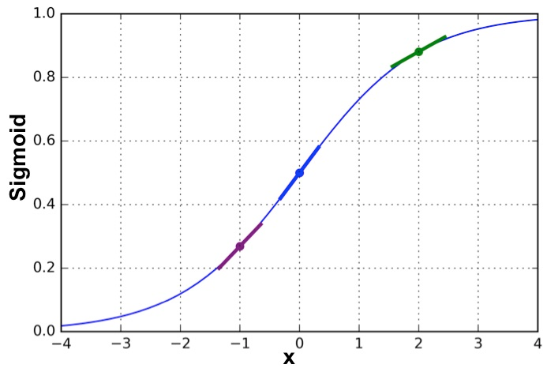
z

Slide 43
Weights update rules
Weights Delta = Error × slope × input

Slide 44
Go through an Example
Sample | Feature 1 | Feature 2 | Feature 3 | Target
Sample 1 | 0 | 0 | 1 | 0
Sample 2 | 1 | 1 | 1 | 1
Sample 3 | 1 | 0 | 1 | 1
Sample 4 | 0 | 1 | 1 | 0
Sample 5 | 1 | 0 | 0 | 1

Slide 45
How to deal with errors
Sample | Feature 1 | Feature 2 | Feature 3 | Target
Sample 1 | 1 | 1 | 1 | 1
Input
1
X
-0.166
Output
0.441
1
Σ
f
y
-1.000
1
-0.395
Σ = (-0.166)×1 + 0.441×1 + (-1)×1 + (-0.395)×1
= -1.12
f(-1.12) = 1/(1+e^{-1.12}) = 0.246
Error = 1 – 0.246 = 0.754
1

Slide 46
We want to increase the weights to make the z value next time larger

Slide 47
Change item = 0.754 × slope × input

Slide 48
z = -1.12 f(z) = 0.246
slope = 0.246 × (1 - 0.246) = 0.185
z

Slide 49
1
1
1
1
Change item = 0.754 × 0.185 ×
0.139
0.139
0.139
0.139
=

Slide 50
Changes of the error
-0.166
0.441
-1.000
-0.395
0.139
0.139
0.139
0.139
-0.027
0.580
-0.861
-0.256
Updated
Weights
=
+
=
Original
Weights
updates

Slide 51
Changes of the error
-0.166
0.441
-1.000
-0.395
0.139
0.139
0.139
0.139
-0.027
0.580
-0.861
-0.256
Updated
Weights
=
+
=
Error of next iteration
z = (-0.027)×1 + 0.580×1 + (-0.861)×1 + (-0.256) ×1 = -0.564
f(z) = 0.637
Error = 1 – 0.637 = 0.363

Slide 52

Changes of the error
0.754
0.363

Slide 53

Iterate many times

Slide 54
Go to notebook 01

Slide 55
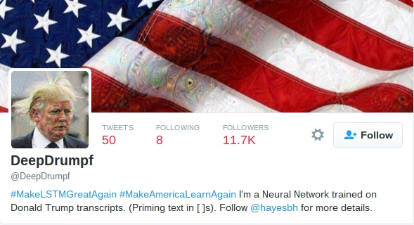
DeepDrumpf
https://twitter.com/DeepDrumpf
https://www.pastemagazine.com/articles/2016/03/an-mit-scientist-created-a-trump-twitter-bot-and-i.html

Slide 56
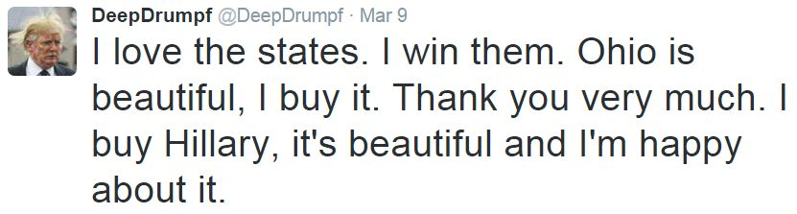
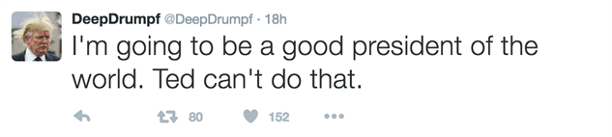

Slide 57
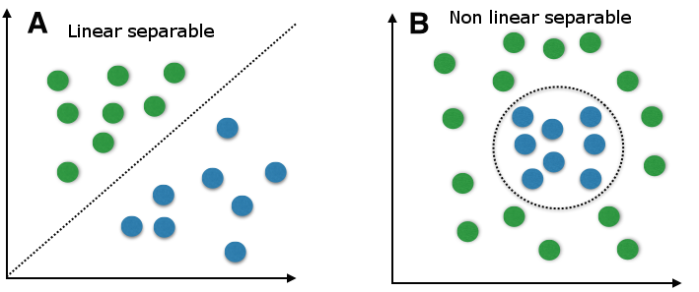
Perceptron limitations

Slide 58

Winter of ANN

Slide 59
Multi-Layer Perceptron

Slide 60
Input
1
1
Hidden1
Σ | f
X
Output
feature1
Hidden2
Σ | f
Σ
f
y
feature2
Hidden3
Σ | f
X – input data
y – output target
Σ – summation
f – activation function
blue circle - bias
feature3
Hidden4
Σ | f

Slide 61
Input
1
1
Hidden1
Σ | f
X
Output
feature1
Hidden2
Σ | f
Σ
f
y
feature2
Hidden3
Σ | f
X – input data
y – output target
Σ – summation
f – activation function
blue circle - bias
feature3
Hidden4
Σ | f

Slide 62
Input
1
1
Hidden1
Σ | f
X
Output
feature1
Hidden2
Σ | f
Σ
f
y
feature2
Hidden3
Σ | f
X – input data
y – output target
Σ – summation
f – activation function
blue circle - bias
feature3
Hidden4
Σ | f

Slide 63
Go to notebook 02

Slide 64
Real world example
Sklearn example
Step by step ANN
Perceptron
Backpropagation
Learning curve
Gentle introduction
What’s ML
ANN history
ANN overview
Workshop time

Slide 65
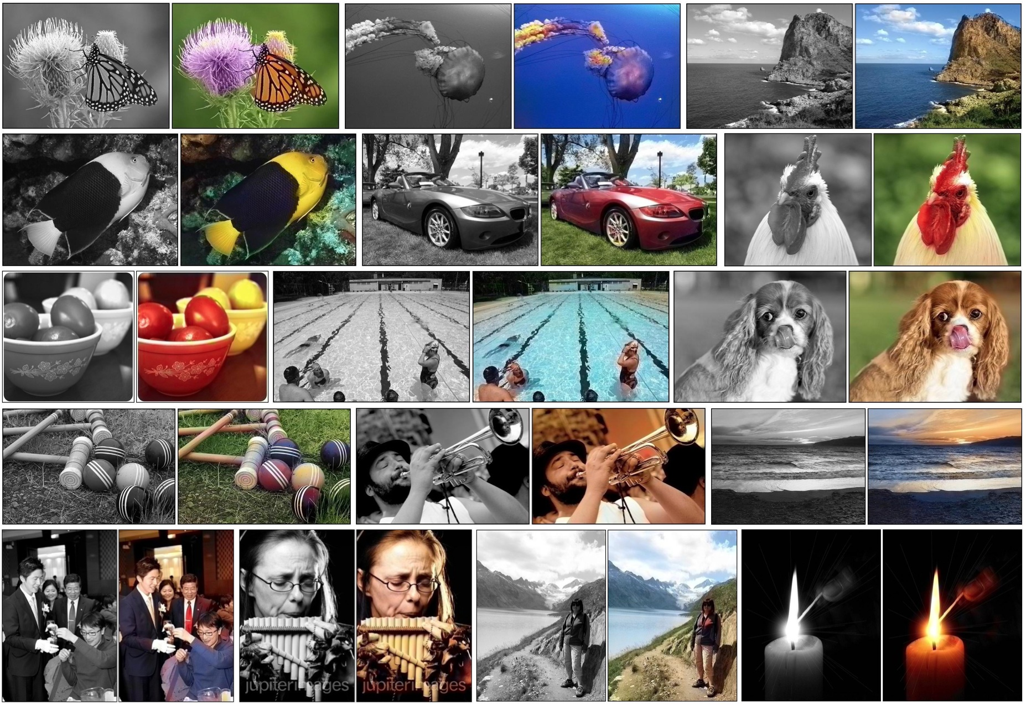
http://whattogive.com/videoColourization/
http://richzhang.github.io/colorization/

Slide 66
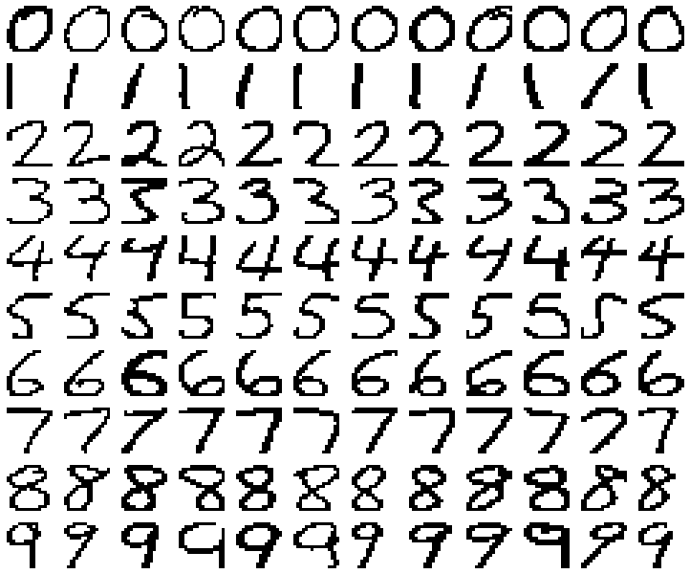

Slide 67
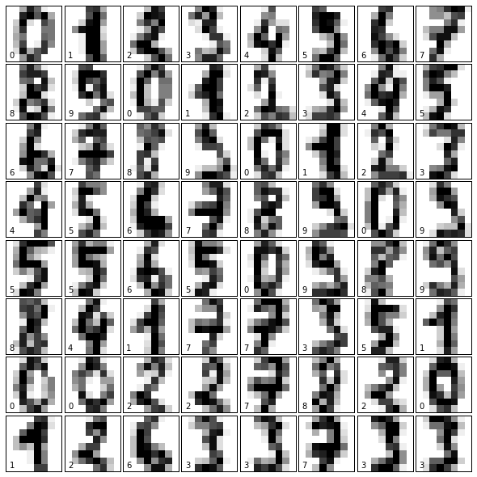

Slide 68
Go to notebook 03

Slide 69


Slide 70
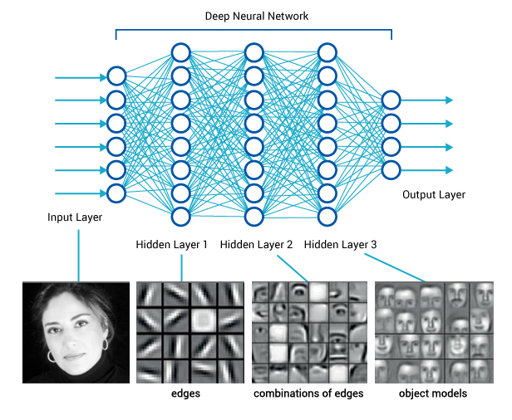

Slide 71
Some useful resources
http://iamtrask.github.io/2015/07/12/basic-python-network/
https://seat.massey.ac.nz/personal/s.r.marsland/MLBook.html
http://sebastianraschka.com/Articles/2015_singlelayer_neurons.html
http://www.emergentmind.com/neural-network
http://neuralnetworksanddeeplearning.com/
You can also find most of today’s workshop material on my blog:
http://qingkaikong.blogspot.com/2016/10/machine-learning-1-what-is-machine.html

Slide 72


Slide 73
https://www.youtube.com/watch?v=tWdaMKKH5MI

